Slide 1
STATE GOVERNMENT
REFERS TO THE GOVERNING BODY AT THE STATE LEVEL

Slide 2
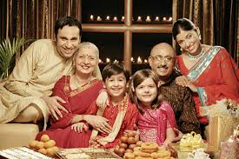
IN OUR LIFE
A FAMILY CONSISTS OF THE GRANDPARENTS , PARENTS AND CHILDREN.

Slide 3
(in the state)
THE STATE GOVERNMENT
FAMILY
STATE GOVERNMENT
1. NOMINAL HEAD- GRANDPARENT
2. REAL HEAD-PARENTS
1. NOMINAL HEAD- THE GOVERNOR
2. REAL HEAD- CHIEF MINISTER

Slide 4
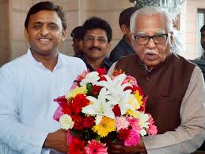
The real head /nominal head

Slide 5
Now the next question -
who becomes the chief minister?
The chief minister is elected through a majority in the state legislative assembly. The leader of the party that wins the election by getting the majority of the votes is sworn in as the chief minister by the Governor.

Slide 6
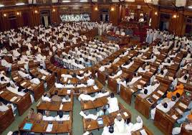
How is the majority determined
Lets take the example of Uttar Pradesh. It has 403 seats in the Vidhan Sabha.

Slide 7
So any party that secures more than half the votes, ie ,
403/2 =202
The leader of this party- chief minister

Slide 8
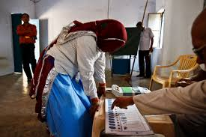
LETS SUMMARIZE
What is the meaning of State Government?
Who is the nominal head and who is the real head?
How does a party come to power?
Who becomes the chief minister?

